Slide 1
修咸頓
升學講座
（大學篇）
Speaker:
Percia (修咸頓大學職業治療學生)
Simon (修咸頓大學應屆心理系畢業生)
24/8/2024

Slide 2
Agenda
01
02
03
04
UCAS Application
Personal statement點寫？
大學面試點準備？
點揀大學？//大學生活

Slide 3
01
UCAS Application

Slide 4
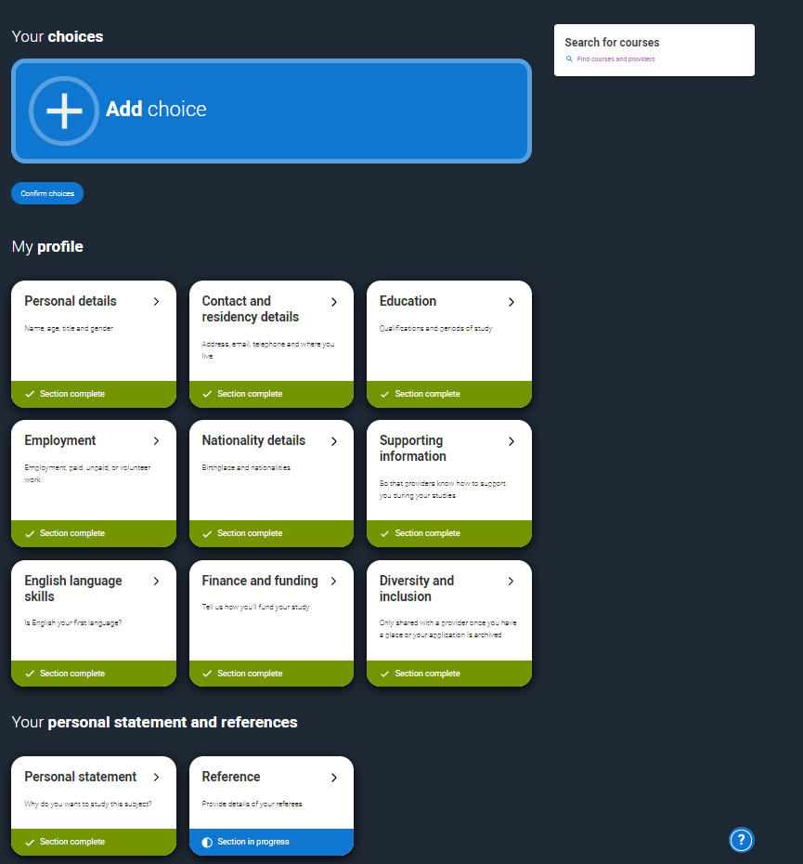
Steps
Register with UCAS
Complete personal details
Add education history
Complete employment history
Select course choices (max 5)
Personal statement
Submit application
Get a reference(from your school), pay the application fee
https://www.ucas.com/undergraduate/applying-university/filling-your-ucas-undergraduate-application

Slide 5
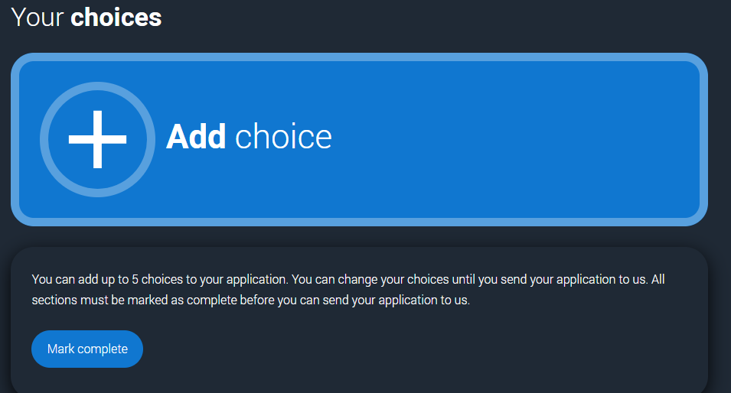
Choices
Maximum: choose 5 courses
No need to number your preferences
Normally starting Feb 2025 each university will give you either
1)Unconditional Offer
2)Conditional Offer
3)Unsuccessful

Slide 6
What is Extra?
Criteria:
Applicants who have used all five choices and are not holding any offers or rejected all their offers
-> could find a place using Extra (late Feb to early July)
1. Apply for the new course.
2. Add the details to your application. If after 21 days you don’t hear back -> either continue to wait or add a new choice
https://www.ucas.com/undergraduate/after-you-apply/types-undergraduate-offers/extra-choices

Slide 7
What is Clearing?
Criteria:
-If you are applying after 30 June
-If you didn’t receive any offers (or none you wanted to accept)
-If you didn’t meet the conditions of your offers
-If you have declined your firm choice using the ‘decline my place’ button
When will this happen? Early July to mid Oct
https://www.ucas.com/undergraduate/clearing-and-results-day/what-clearing

Slide 8
IMPORTANT DATES !!!
When are the application deadlines?
Tue 15 October 2024 - 18:00
-Oxbridge
-Medicine
-Veterinary Medicine
-Dentistry
Wed 29 January 2025 - 18:00
All other undergraduate courses, except those courses listed on the left.
NOTE IT DOWN !

Slide 9
02
Personal statement

Slide 10
2025 UCAS entry
One long piece of text
4000 characters (includes spaces) or 47 lines of text, whichever comes first.
DO NOT use bold, underline or italics.
Formal writing i.e. do not use short forms
Write in first person

Slide 11
https://www.ucas.com/system/files/scotland_-_secrets_to_a_powerful_personal_statement_pdf.pdf

Slide 12
What has changed?
2026 onwards:
Three separate sections instead of one long piece of text.
Each section: minimum 350 characters
The 3 new sections:
-Why do you want to study this course or subject?
-How have your qualifications and studies helped you to prepare for this course or subject?
-What else have you done to prepare outside of education, and why are these experiences useful?

Slide 13
What hasn’t changed?
2026 onwards:
-The personal statement will still be 4000 characters in total(includes spaces).
-The content of the personal statement will still be the same

Slide 14
What to write in the Personal Statement?
Describe the event/person/thing that sparked your interest in the subject.
Work experience
Volunteering
Any activities/clubs that taught you skills which equip you for your subject
What other skills do you have that is considered as essential in your particular subject?

Slide 15
TOP TIPS
-Demonstrate your interest
-Site examples(be specific) e.g. what communication skills have you demonstrated?
-Look at the qualities needed for the subject/course
-What do you look forward to doing as e.g. a doctor/ an engineer?

Slide 16
TOP TIPS
-Tell them what you KNOW about the subject
-Related experience eg work experience/volunteering/shadowing/ clubs and activities / competition
-NO plagiarism (抄襲)

Slide 17
03
大學面試

Slide 18
INTERVIEWS?
NOT ALL UNIVERSITIES REQUIRE YOU TO ATTEND AN INTERVIEW!!!
Universities that tend to interview: Oxford, Cambridge
Courses that tend to interview: Healthcare
(e.g. Med, Dentistry, Nursing, PT, OT etc), Education, Music, Art & Design

Slide 19
Common Questions
Tell me about yourself (Self Intro)
Why do you want to study this course?
Knowledge regarding subject
Extracurricular activities
What are your strengths and weakness? Relate it to your course
Why do you want to study in this uni?

Slide 20
WHEN ARE THE INTERVIEWS?

Slide 21
04
大學選擇/
大學生活

Slide 22
大學排名？
費用?
課程設計?
Entry Requirement？
Employability？
地理位置/
環境？

Slide 23
大學排名

Slide 24
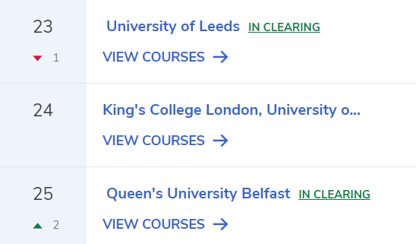
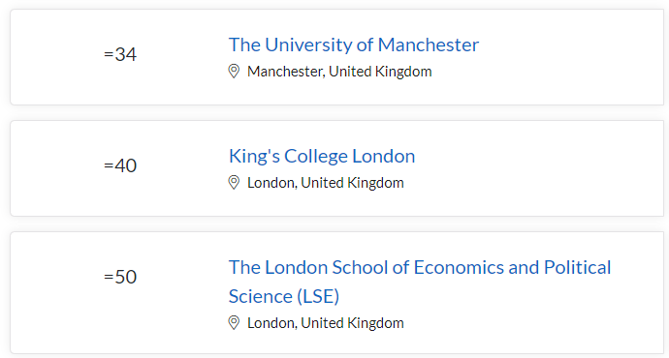
National Rankings (Complete/Guardian )
International Rankings (QS/THE )
National Ranking #7

Slide 25
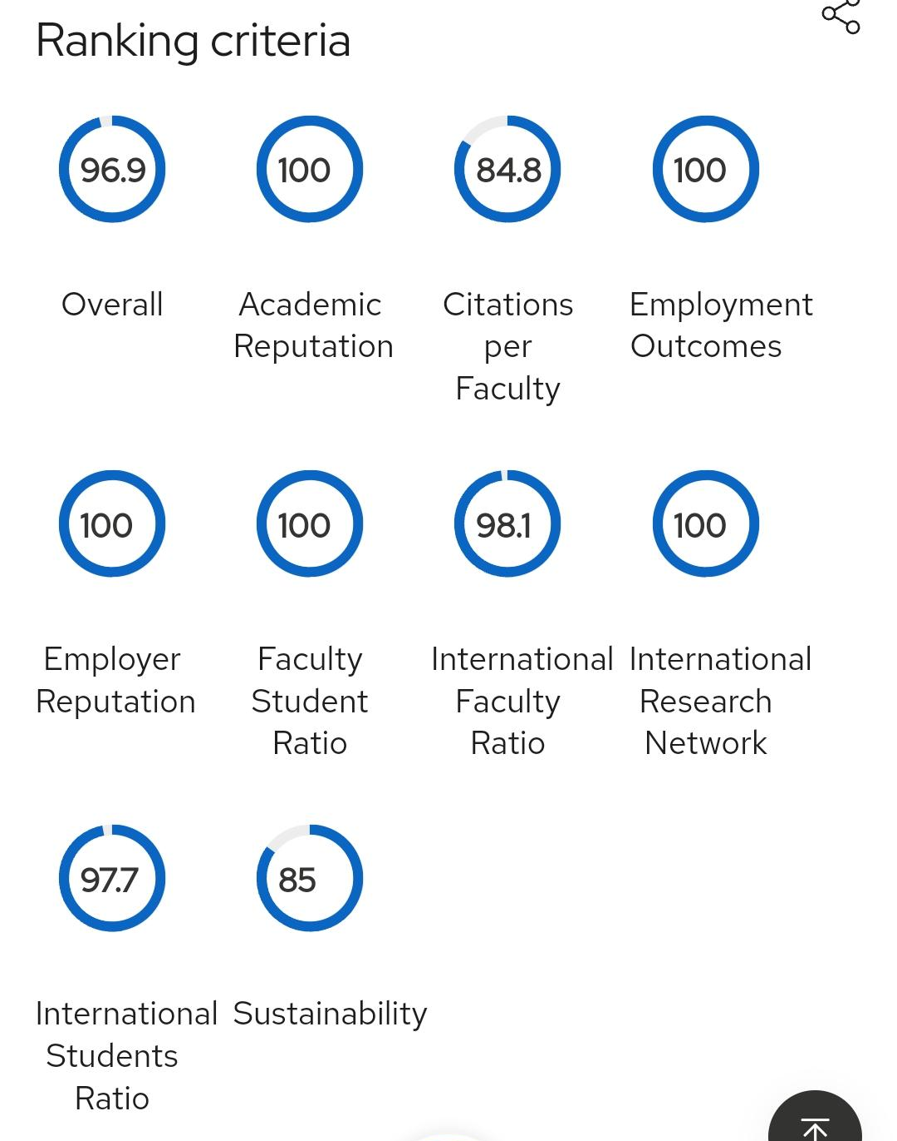
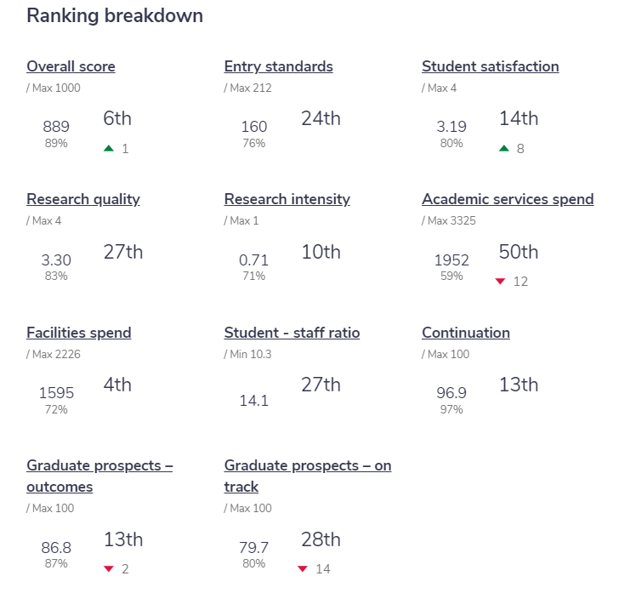
Complete University
Guide
QS:

Slide 26
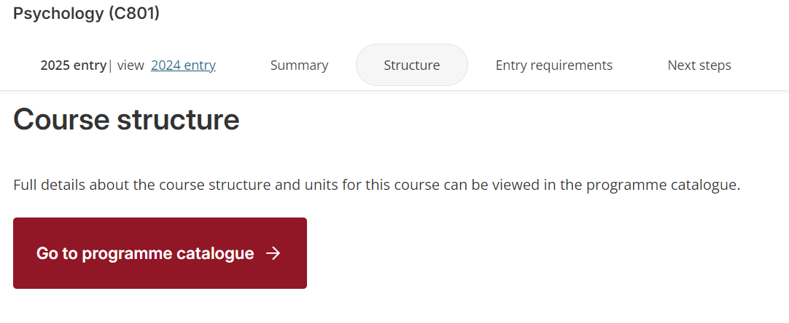
Course Structure

Slide 27
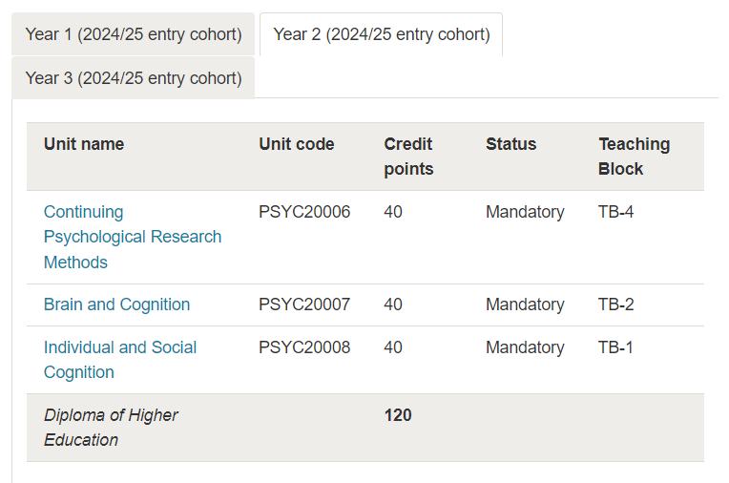

Slide 28
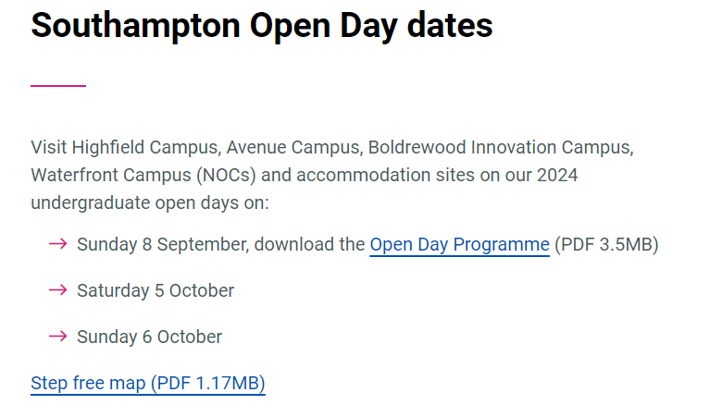

Slide 29
大學生活
讀書
「過三爆四」
上莊
拍拖
做兼職
住hall

Slide 30
大學生活
英國大學學士普遍只有短短三年(兩個暑假)，
大學校園生活應該由自己定義同埋好好珍惜
Some recommendations:
Internship/ Part-time
Join 多啲 Clubs/Societies
上莊

Slide 31
Thanks!
祝大家升學順利
A-level Gayau!!!

